Slide 1

THE UNFAIR
GAME
SPAG EDITION

Slide 2

RULES
  This game isn’t fair!
  Get into teams of 6.
  Teams take turns to answer the SPAG questions. If you can’t answer, the question is passed to another team.
  If your team gets the answer correct, you can decide if you will keep the points or give them to the other team.
You MUST decide this quickly as a team before seeing the point
value.
  Questions have randomly assigned point values.
Some may be positive while others are negative.

Slide 3
RULES
  So you might win a lot of points, or you might have to deduct points from your score.
  You might pass positive points to another team, or they might have to deduct points from their score.
  The teacher’s decision is final. Arguing not allowed. Shouting not allowed. Points will be awarded to other teams if rules are broken.
  Remember it is a game. Even if you lose, at least you aren’t doing a mock test!
  A reminder - this game isn’t fair! Enjoy!

Slide 4
ARE YOU READY?

Slide 5



REWRITE IN ACTIVE VOICE
A game will be played by the children.
REWRITE IN PASSIVE VOICE
Two centuries ago, explorers discovered the lost city.

Slide 6
ANSWER
The children will play a game.
The children will be playing a game.
ANSWER
Two centuries ago, the city was discovered by explorers.
The city was discovered by explorers two centuries ago.

Slide 7

DECISION TIME
KEEP YOUR POINTS?
OR
GIVE AWAY YOUR POINTS?
SCORE REVEALED ON NEXT SLIDE

Slide 8




Slide 9

FIND THE FOUR DETERMINERS IN THE SENTENCE BELOW.
The tiny puppies ate some food, wagged their tails and tried to jump on my bed.

Slide 10
ANSWER
___ tiny puppies ate ____ food, wagged ____ tails and tried to jump on ___ bed.
The
some
some
their
my

Slide 11
DECISION TIME
KEEP YOUR POINTS?
OR
GIVE AWAY YOUR POINTS?
SCORE REVEALED ON NEXT SLIDE

Slide 12
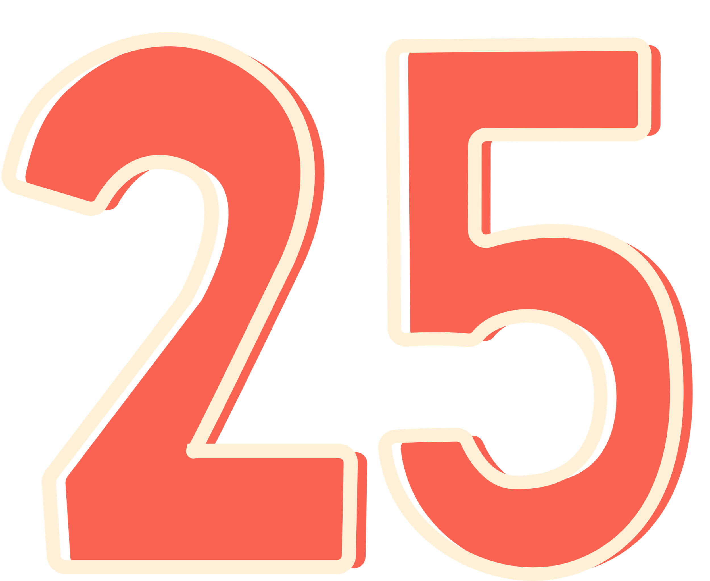

Slide 13

WHICH SENTENCE IS A COMMAND?
The pencils must be put away.
You should tidy up.
I expect you to tidy your desk
Before you go home, tidy up.

Slide 14
ANSWER
The pencils must be put away.
You should tidy up.
I expect you to tidy your desk
Before you go home, tidy up.

Slide 15
DECISION TIME
KEEP YOUR POINTS?
OR
GIVE AWAY YOUR POINTS?
SCORE REVEALED ON NEXT SLIDE

Slide 16





Slide 17

WHICH SENTENCES REQUIRE A QUESTION MARK?
How tall you have grown
What are you doing tomorrow
What a windy day it is
How do I answer this question

Slide 18
ANSWER
How tall you have grown!
What are you doing tomorrow?
What a windy day it is!
How do I answer this question?

Slide 19
DECISION TIME
KEEP YOUR POINTS?
OR
GIVE AWAY YOUR POINTS?
SCORE REVEALED ON NEXT SLIDE

Slide 20



Slide 21

IN WHICH SENTENCE IS THE WORD FROWN USED AS A VERB?
The teacher's frown silenced the noisy classroom.
With a slight frown, she read the confusing instructions.
Holly couldn't help but frown when she heard the disappointing news.
She greeted him with a warm smile, despite the deep frown on his face.

Slide 22
ANSWER
The teacher's frown silenced the noisy classroom.
With a slight frown, she read the confusing instructions.
Holly couldn't help but frown when she heard the disappointing news.
She greeted him with a warm smile, despite the deep frown on his face.

Slide 23
DECISION TIME
KEEP YOUR POINTS?
OR
GIVE AWAY YOUR POINTS?
SCORE REVEALED ON NEXT SLIDE

Slide 24


Slide 25

HOW DOES THE COMMA CHANGE THE SENTENCE?
a. Mum wanted to know whether Amelia Jane and Rae were invited to my party.
b. Mum wanted to know whether Amelia, Jane and Rae were invited to my party.

Slide 26
ANSWER
a. Mum wanted to know whether Amelia Jane and Rae were invited to my party.
b. Mum wanted to know whether Amelia, Jane and Rae were invited to my party.
This sentence mentions two people coming to the party - Amelia Jane is one person.
This sentence mentions three people coming to the party Amelia and Jane are separate people.

Slide 27
DECISION TIME
KEEP YOUR POINTS?
OR
GIVE AWAY YOUR POINTS?
SCORE REVEALED ON NEXT SLIDE

Slide 28


Slide 29

WHICH WORD IS THE ADVERB?
When I got home, my cat was still sleeping on my bed.

Slide 30
ANSWER
still
When I got home, my cat was
sleeping on my bed.

Slide 31
DECISION TIME
KEEP YOUR POINTS?
OR
GIVE AWAY YOUR POINTS?
SCORE REVEALED ON NEXT SLIDE

Slide 33

MATCH EACH PREFIX TO A WORD TO MAKE FOUR DIFFERENT WORDS.
im
active
in
judge
ir
patient
mis
reversible

Slide 34
ANSWER
im
active
in
judge
ir
patient
mis
reversible

Slide 35
DECISION TIME
KEEP YOUR POINTS?
OR
GIVE AWAY YOUR POINTS?
SCORE REVEALED ON NEXT SLIDE

Slide 37

FIND THE VERB FORM THAT IS IN THE PRESENT PERFECT.
Cleo adores stories and she has enjoyed countless books over the years. Yesterday, she was reading an amazing mystery novel, and was surprised when she realised how late it was.

Slide 38
ANSWER
has enjoyed
Cleo adores stories and she ...................
countless books over the years. Yesterday, she was reading an amazing mystery novel, and was surprised when she realised how late it was.

Slide 39
DECISION TIME
KEEP YOUR POINTS?
OR
GIVE AWAY YOUR POINTS?
SCORE REVEALED ON NEXT SLIDE

Slide 40


Slide 41


WHICH OPTION COMPLETES THE SENTENCE IN PRESENT PROGRESSIVE?
He _______a delicious dinner for his family.
a) cooks
b) has cooked
c) will cook
d) is cooking

Slide 42
ANSWER
He _______a delicious dinner for his family.
a) cooks
b) has cooked
c) will cook
d) is cooking

Slide 43
DECISION TIME
KEEP YOUR POINTS?
OR
GIVE AWAY YOUR POINTS?
SCORE REVEALED ON NEXT SLIDE

Slide 44


Slide 45
REWRITE THE UNDERLINED VERBS IN THE SIMPLE PAST.
As the clock strikes midnight, the streets become quieter, and the city settles into sleep.

Slide 46
ANSWER
As the clock _____ midnight, the streets ______ quieter, and the city ____ into sleep.
struck
became
settled

Slide 47
DECISION TIME
KEEP YOUR POINTS?
OR
GIVE AWAY YOUR POINTS?
SCORE REVEALED ON NEXT SLIDE

Slide 48
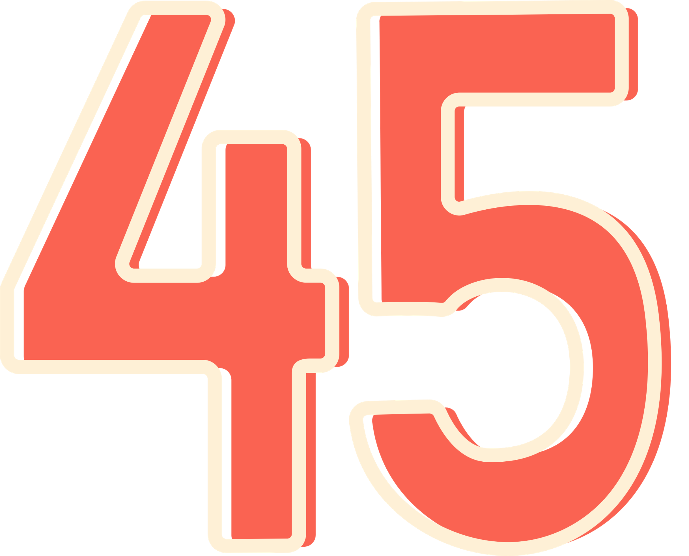

Slide 49
WHICH SENTENCE IS THE MOST FORMAL?
a) Shall we grab a bite to eat at that new restaurant?
b) I suggest we dine at the new restaurant in the city centre.
d) Shall we eat lunch at the new spot with the five star reviews?
c) Let’s dine at that new restaurant in town.

Slide 50
ANSWER
a) Shall we grab a bite to eat at that new restaurant?
b) I suggest we dine at the new restaurant in the city centre.
d) Shall we eat lunch at the new spot with the five star reviews?
c) Let’s dine at that new restaurant in town.

Slide 51
DECISION TIME
KEEP YOUR POINTS?
OR
GIVE AWAY YOUR POINTS?
SCORE REVEALED ON NEXT SLIDE

Slide 53






MATCH THE LETTER TO EACH BOX TO SHOW THE WORD CLASS.
The curious cat stealthily explored the garden at night.
adverb
adjective
determiner
preposition
verb
noun

Slide 54






ANSWER
The curious cat stealthily explored the garden at night.
adverb
adjective
determiner
preposition
verb
noun

Slide 55
DECISION TIME
KEEP YOUR POINTS?
OR
GIVE AWAY YOUR POINTS?
SCORE REVEALED ON NEXT SLIDE

Slide 56


Slide 57

FIND THE POSSESSIVE PRONOUN.
Susan borrowed Joe's umbrella because she had left hers at home.

Slide 58
ANSWER
Susan borrowed Joe's umbrella because she had left ........... at home.
hers

Slide 59
DECISION TIME
KEEP YOUR POINTS?
OR
GIVE AWAY YOUR POINTS?
SCORE REVEALED ON NEXT SLIDE

Slide 60


Slide 61
WHICH SENTENCE IS PUNCTUATED CORRECTLY?
a) My coach always says “Stay focused and keep pushing.”
b) My coach always says, “stay focused and keep pushing.”
c) My coach always says, “Stay focused and keep pushing.”
d) “My coach always says, Stay focused and keep pushing.”

Slide 62
ANSWER
a) My coach always says “Stay focused and keep pushing.”
b) My coach always says, “stay focused and keep pushing.”
c) My coach always says, “Stay focused and keep pushing.”
d) “My coach always says, Stay focused and keep pushing.”

Slide 63
DECISION TIME
KEEP YOUR POINTS?
OR
GIVE AWAY YOUR POINTS?
SCORE REVEALED ON NEXT SLIDE

Slide 64


Slide 65
WHICH SENTENCE IS PUNCTUATED CORRECTLY?
a) Add 30 grams (approximately two tablespoons) of butter
to the mixture.
b) Add 30 grams approximately (two tablespoons) of butter
to the mixture.
c) Add (30 grams approximately two tablespoons) of
butter to the mixture.
d) Add 30 grams approximately two tablespoons (of butter
to the mixture.)

Slide 66
ANSWER
a) Add 30 grams (approximately two tablespoons) of butter
to the mixture.
b) Add 30 grams approximately (two tablespoons) of butter
to the mixture.
c) Add (30 grams approximately two tablespoons) of
butter to the mixture.
d) Add 30 grams approximately two tablespoons (of butter
to the mixture.)

Slide 67
DECISION TIME
KEEP YOUR POINTS?
OR
GIVE AWAY YOUR POINTS?
SCORE REVEALED ON NEXT SLIDE

Slide 69
WHICH SENTENCE IS PUNCTUATED CORRECTLY?
a) Ted designs amazing-one-of-a-kind birthday cakes in
his bakery.
b) Ted designs amazing one-of-a-kind-birthday-cakes in
his bakery.
c) Ted designs amazing one-of-a-kind birthday cakes in
his bakery.
d) Ted designs amazing one of a kind birthday-cakes in
his bakery.

Slide 70
ANSWER
a) Ted designs amazing-one-of-a-kind birthday cakes in
his bakery.
b) Ted designs amazing one-of-a-kind-birthday-cakes in
his bakery.
c) Ted designs amazing one-of-a-kind birthday cakes in
his bakery.
d) Ted designs amazing one of a kind birthday-cakes in
his bakery.

Slide 71
DECISION TIME
KEEP YOUR POINTS?
OR
GIVE AWAY YOUR POINTS?
SCORE REVEALED ON NEXT SLIDE

Slide 72


Slide 73

WHAT IS THE GRAMMATICAL TERM FOR THE UNDERLINED WORDS?
The boy with bright blue eyes and a huge smile is my best friend.
a fronted adverbial
a subordinate clause
a)
b)
a main clause
a noun phrase
c)
d)

Slide 74
ANSWER
The boy with bright blue eyes and a huge smile is my best friend.
a fronted adverbial
a subordinate clause
a)
b)
a main clause
a noun phrase
c)
d)

Slide 75
DECISION TIME
KEEP YOUR POINTS?
OR
GIVE AWAY YOUR POINTS?
SCORE REVEALED ON NEXT SLIDE

Slide 76


Slide 77

WHICH TWO SENTENCES CONTAIN A PREPOSITION?
a) Violet baked cookies on Friday evening.
b) She measured and mixed the ingredients carefully.
c) Her sister tasted the delicious cookies after dinner.
d) Violet's sister told her that the cookies were delicious.
e) After finishing her homework, Violet ate two more cookies.

Slide 78
ANSWER
a) Violet baked cookies on Friday evening.
b) She measured and mixed the ingredients carefully.
c) Her sister tasted the delicious cookies after dinner.
d) Violet's sister told her that the cookies were delicious.
e) After finishing her homework, Violet ate two more cookies.

Slide 79
DECISION TIME
KEEP YOUR POINTS?
OR
GIVE AWAY YOUR POINTS?
SCORE REVEALED ON NEXT SLIDE

Slide 80


Slide 81


ARE THESE STATEMENTS ABOUT APOSTROPHES TRUE OR FALSE?
Sentence | The apostrophe shows that... | True | False
a) The teacher's books
were piled high.
there is only one teacher.
b) The students' books
were stacked neatly.
there is only one student.
c) The birds' nest was
empty.
there is more than one bird.
d) The painters' brushes
were lined up neatly.
there is only one painter.
e) The passenger’s tickets
needed to be checked.
there is more than one passenger.

Slide 82

ANSWER
Sentence | The apostrophe shows that... | True | False
a) The teacher's books
were piled high.
there is only one teacher.
b) The students' books
were stacked neatly.
there is only one student.
c) The birds' nest was
empty.
there is more than one bird.
d) The painters' brushes
were lined up neatly.
there is only one painter.
e) The passenger’s tickets
needed to be checked.
there is more than one passenger.

Slide 83
DECISION TIME
KEEP YOUR POINTS?
OR
GIVE AWAY YOUR POINTS?
SCORE REVEALED ON NEXT SLIDE

Slide 85
GREAT JOB!
THE END

